Slide 1
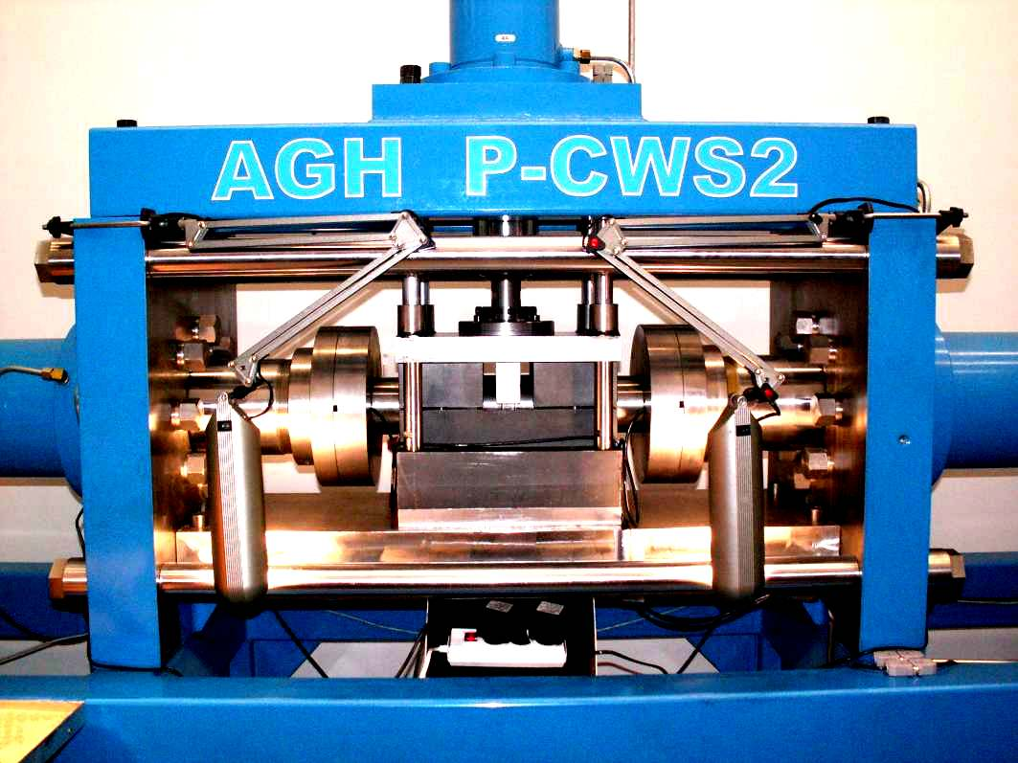
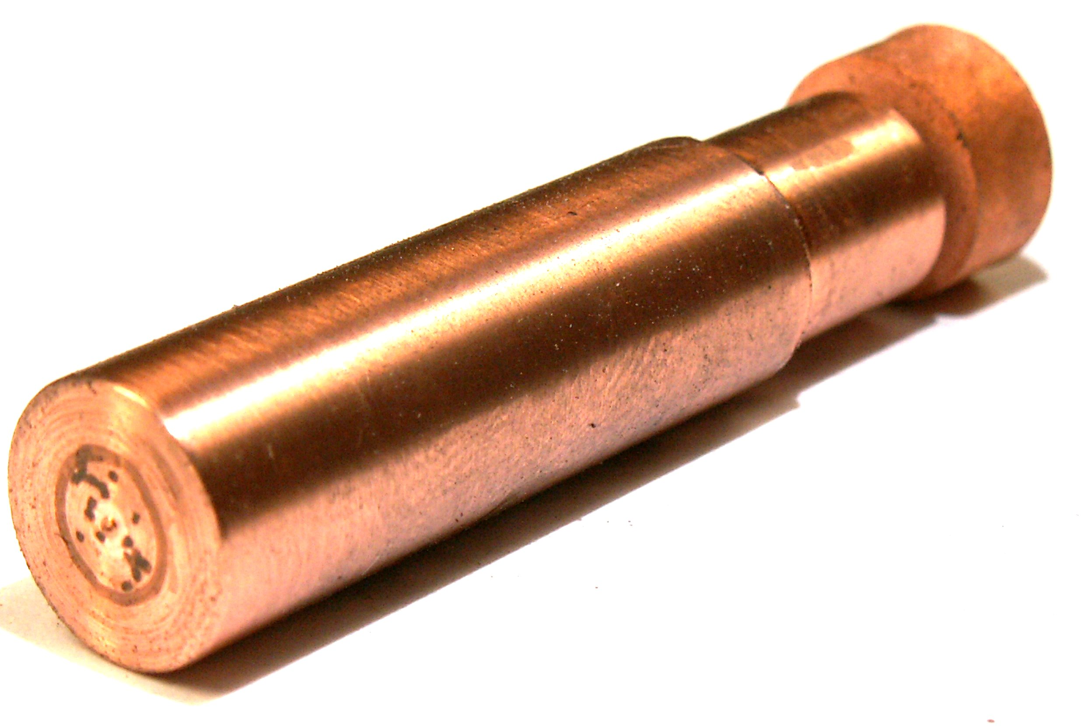
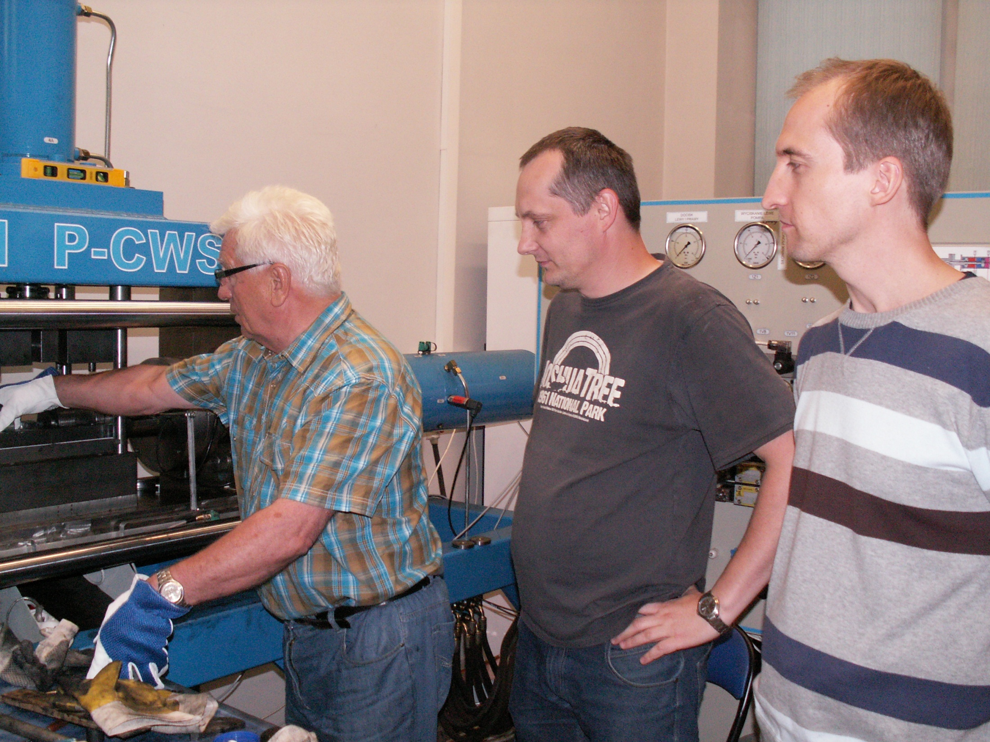
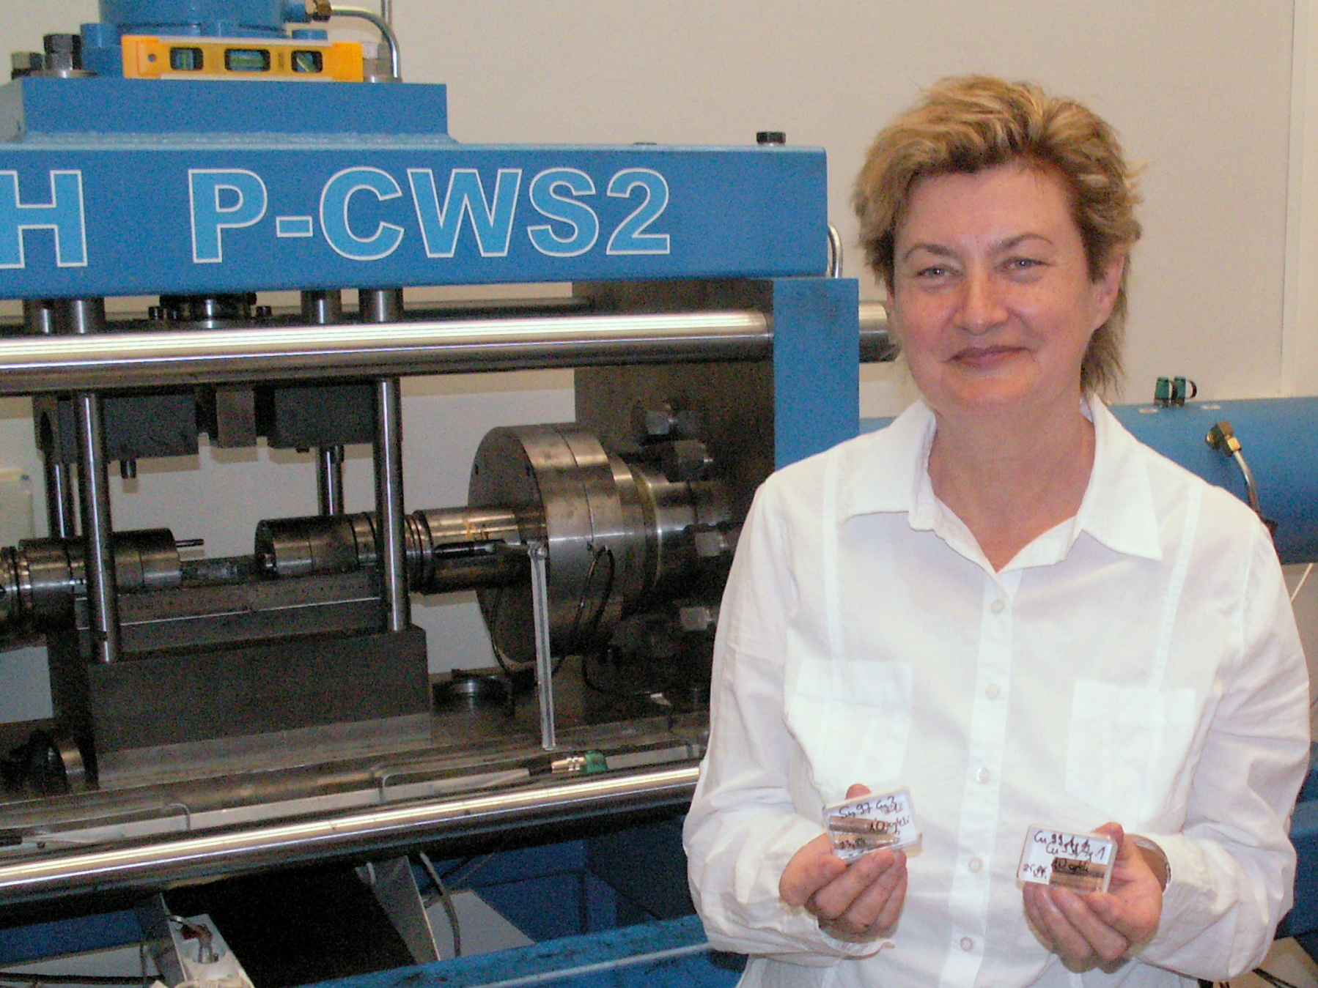
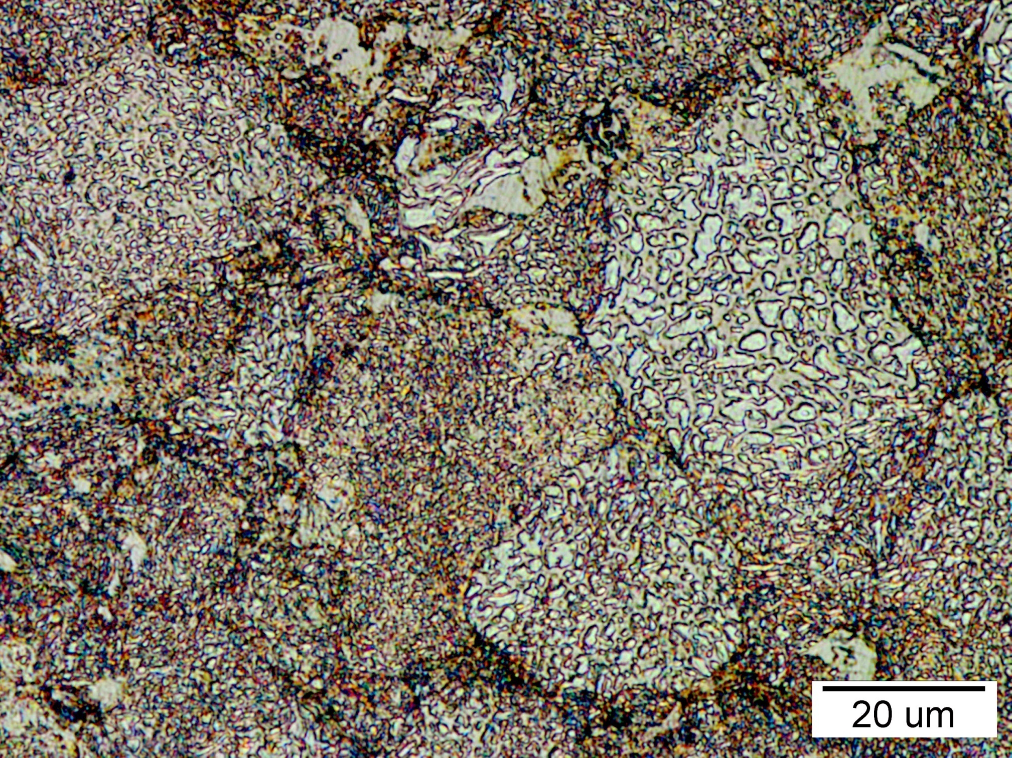
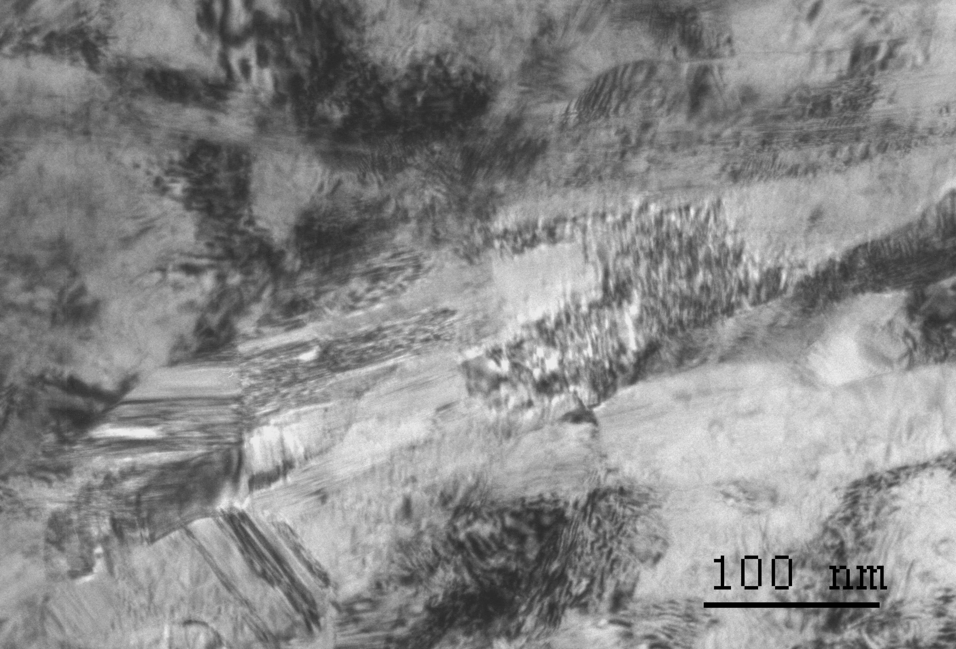
Project realised in the frame of Progam of Innovative Economy, years: 2007-2013 Project No POIG.01.01.02-00-015/09-00 - „Advanced Materials and Technologs of their Manufacturing”
Task realized in AGH Krakow: Task I.3.2
„Effect of Severe Plastic Deformations, Exerted by the CEC Method, on the Consolidated Powders Microstructure Refinement”
Project concerns consolidation of powders, used as electrical contacts, by original cyclic extrusion compression (CEC) method (reciprocal extrusion) and their investigations . Low porosity and almost equiaxial garnules are characteristic feature of microstructure of consolidated powders. Inside granules nanometric in size grains and microtwins with the width of about few nanometers were found.

