Slide 1

Modern physics
Historical introduction to quantum mechanics
dr hab. inż. Katarzyna ZAKRZEWSKA, prof. AGH
KATEDRA ELEKTRONIKI, C-1, office 317, 3rd floor, phone 617 29 01, mobile phone 0 601 51 33 35
e-mail: zak@agh.edu.pl, Internet site http://home.agh.edu.pl/~zak

Slide 2
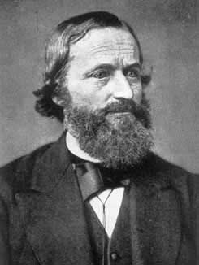
Historical introduction to quantum mechanics
Gustav Kirchhoff (1824-1887)
Surprisingly, the path to quantum mechanics begins with the work of German physicist Gustav Kirchhoff in 1859.
Electron was discovered by J.J.Thomson in 1897 (neutron in 1932)
The scientific community was reluctant to accept these new ideas. Thomson recalls such an incident: „I was told long afterwards by a distinguished physicist who had been present at my lecture that he thought I had been pulling their leg”.

Slide 3
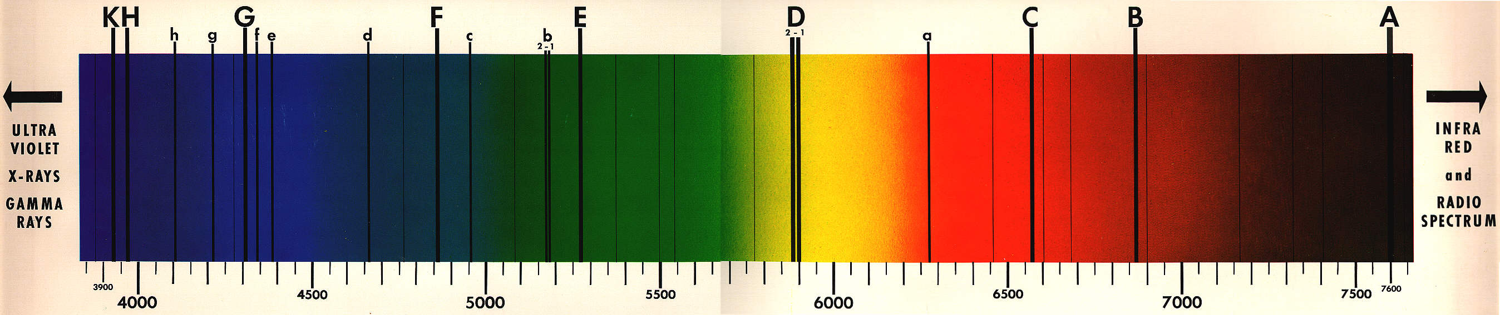
Historical introduction to quantum mechanics
Kirchhoff discovered that so called D-lines from the light emitted by the Sun came from the absorption of light from its interior by sodium atoms at the surface.
Kirchhoff could not explain selective absorption. At that time Maxwell had not even begun to formulate his electromagnetic equations.
Statistical mechanics did not exist and thermodynamics was in its infancy

Slide 4
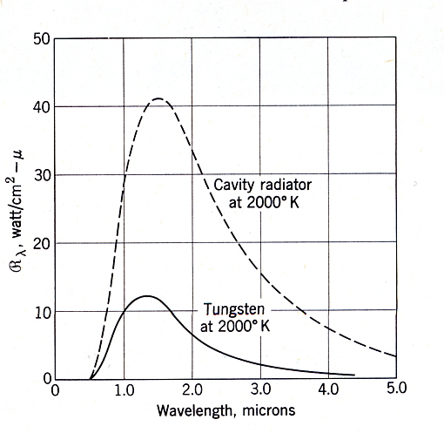
Historical introduction to quantum mechanics
At that time it was known that heated solids (like tungsten W) and gases emit radiation.
Spectral radiancy R_{λ} is defined in such a way that R_{λ} dλ is the rate at which energy is radiated per unit area of surface for wavelengths lying in the interval λ to λ+d λ.
Total radiated energy R is called radiancy and is defined as the rate per unit surface area at which energy is radiated into the forward hemisphere
The spectral radiancy of tungsten (ribbon and cavity radiator) at 2000 K.

Slide 5
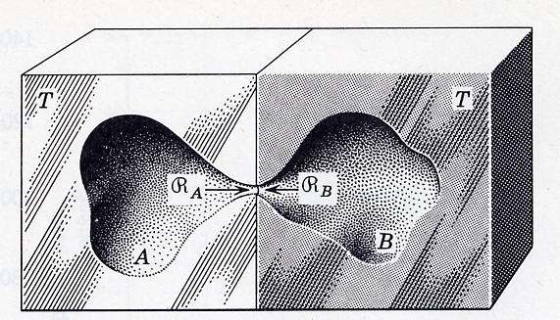
Historical introduction to quantum mechanics
Kirchhoff imagined a container – a cavity –whose walls were heated up so that they emitted radiation that was trapped in the container. Within the cavity, there is a distribution of radiation of all wavelength, λ. Intensity measures the rate at which energy falls in a unit area of surface. The walls of the container can emit and absorb radiation. Intensity distribution K(λ,T) at equilibrium depends on wavelength and temperature but is independent of the properties of the material of the container and the point within container.
distribution function of the radiation intensity
emissivity
coefficient of absorption

Slide 6
Historical introduction to quantum mechanics
Radiation
A small hole cut into a cavity is the most popular and realistic example of the blackbody.
⇒ None of the incident radiation escapes
What happens to this radiation?
Blackbody radiation is totally absorbed within the blackbody
Reflection and absorption
Blackbody = a perfect absorber
Energy density emitted by the blackbody is only the function of wavelength and temperature

Slide 7
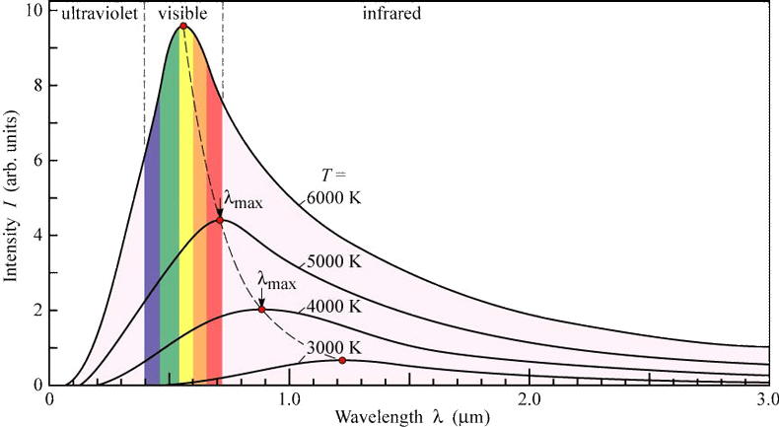
Blackbody radiation
The Sun’s surface is at about 6000 K and this gives λmax=480 nm
Electrical, Computer, & Systems Engineering of Rensselear. §18: Planckian sources and color temperature http://www.ecse.rpi.edu (July 27, 2007).
This result is known as the Wien displacement law
Experimental curve difficult to describe theoretically

Slide 8
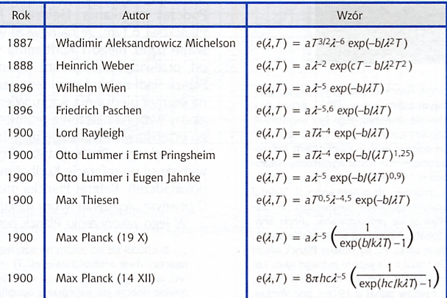
Historical introduction to quantum mechanics
It took a long time to find the exact form of e(λ,T)!
Year
Author
Formulae

Slide 9
Blackbody radiation
u(f,T) is the energy density of the radiation inside the cavity;
u(f,T)df is the energy per unit volume in the frequency range from f to f+df
Radiation in the cavity is isotropic (flowing in no particular direction) and homogeneous (the same at all points inside the cavity).
According to Kirchhoff, the radiation is „universal”: the same in all cavities for a given T and for each frequency, no matter how each cavity is constructed.

Slide 10
Blackbody radiation
The blackbody spectrum attains a maximum at roughly:
This result is known as the Wien displacement law
Since measurements with gratings involve wavelengths, one should convert the distribution in wavelength
The presence of such a maximum is what gives the predominant color to the radiation of a blackbody. The Sun’s surface is at about 6000 K and this gives λ_{max}=480 nm, in the middle of the visible range for the human eye.

Slide 11
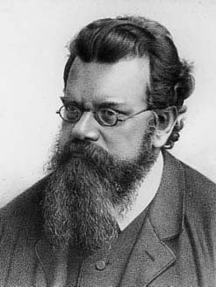
Historical introduction to quantum mechanics
Mid-1880 Austrian theoretical physicist Ludwig Boltzmann using the laws of thermodynamics for an expansion of cylinder with a piston at one end that reflects the blackbody radiation was able to show that the total energy density (integrated over all wavelengths) u_{tot}(T) was given as:
Ludwig Boltzmann
(1835-1893)
σ- Stefan-Boltzmann constant 5.68·10⁻⁸ W/(m² ·K⁴)
By this time Maxwell had formulated his equations. The electromagnetic radiation produces pressure.

Slide 12
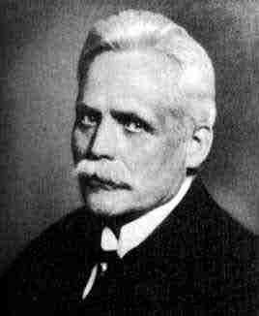
Historical introduction to quantum mechanics
The next important steps forward were taken a decade later by the German Wilhelm Wien, who made two contributions towards finding Kirchhoff’s function K(λ,T). One contribution was based on an analogy between the Boltzmann energy distribution for a classical gas consisting of particles in equilibrium and the radiation in the cavity.
(1864-1928)
The Boltzmann energy distribution describes the relative probability that a molecule in a gas at a temperature T has a given energy E.
This probability is proportional to exp(-E/kT), where k Boltzmann constant 1.38·10⁻²³ J/K, so that higher energies are less likely, and average energy rises with temperature.

Slide 13
Historical introduction to quantum mechanics
Wien’s analogy suggested that it as also less likely to have radiation of high frequency (small wavelength) and that an exponential involving temperature would play a role. Wien’s distribution is given by:
(1864-1928)
a, b are constants to be determined experimentally
In fact, Wien’s analogy is not very good. It fits the small-wavelength (or, equivalently, the high-frequency) part of the blackbody spectrum that experiments were beginning to reveal.
It represents the first attempt to „derive” Kirchhoff’s function from the classical physics which is impossible

Slide 14
Historical introduction to quantum mechanics
Second contribution of Wien (more general observation) that on the basis of thermodynamics alone, one can show that Kirchhoff’s function, or equivalently, the energy density function u(λ,T), is of the form:
(1864-1928)
But this is as far as thermodynamics can go; it cannot determine the function φ.

Slide 15
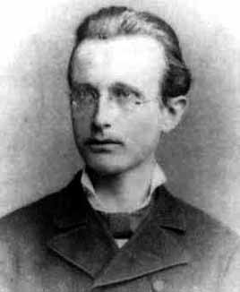
Historical introduction to quantum mechanics
Max Planck was a „reluctant revolutionary”. He never intended to invent the quantum theory, and it took him many years before he began to admit that classical physics was wrong. He was advised against studying physics because all problems had been solved!
(1858-1947)
Planck studied under Kirchhoff at the University of Berlin, and after his death in 1887, Planck succeeded him as a professor of physics there. Planck had a great interest in laws of physics that appeared to be universal. Therefore, he wanted to derive Wien’s law from Maxwell’s electromagnetic theory and thermodynamics. But this cannot be done!!!

Slide 16
Historical introduction to quantum mechanics
Experimentalists
3.02.1899:
experiments performed up 6 µm, T:800-1400ºC indicate deviation from the Wien’ distribution

Slide 17
Historical introduction to quantum mechanics
In order to fit the experimental data of Otto Lummer and Ernst Pringsheim and later Heinrich Rubens and Ferdinand Kurlbaum in 1900, Planck proposed a function:
This function fits very well the experimental data at long wavelengths (infrared) where Wien’s function failed! At short wavelength limit, when
we can neglect the 1 in the denominator and recover the Wien law.

Slide 18
Historical introduction to quantum mechanics
Max Planck finally derived the Kirchhoff formula. He introduced a model of a blackbody that contained „resonators” which were charges that could oscillate harmonically. He applied statistical physics introduced by Boltzmann but had to make a drastic, quite unjustified assumption (at that time):
(1858-1947)
Oscillators can only emit or absorb energy of frequency f in units of hf, where h is a new universal constant with dimensions of energy multiplied by time. Planck called these energy units quanta

Slide 19
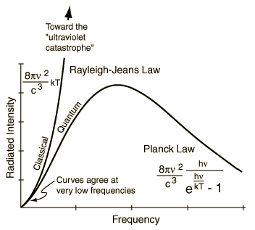
Historical introduction to quantum mechanics
Englishman John Strutt, known as Lord Rayleigh published a paper on Kirchhoff function only some months earlier than Planck (1900). Rayleigh’s idea was to focus on the radiation and not on Planck’s material oscillators. He considered this radiation as being made up of standing electromagnetic waves. Energy density of these waves is equivalent to the energy density of a collection of harmonic oscillators. The average energy per oscillator is kT
This classical approach, so called Rayleigh-Jeans law, leads to the „ultraviolet catastrophe” (integration over all possible frequencies gives infinity for the total energy density of radiation in the cavity)

Slide 20
1.4. Blackbody radiation
The Rayleigh-Jeans treatment of the energy density showed that the classical ideas lead inevitably to a serious problem in understanding blackbody radiation. However, where classical ideas fail, the idea of radiation as photons with energy hf succeeds.
Planck’s formula can be derived within the frame of quantum mechanics:

Slide 21
1.4. Blackbody radiation
The total energy density (the energy density integrated over all frequencies) for the blackbody radiation is a function of the temperature alone:
This result of integration gives the Stefan-Boltzmann law, known earlier
It was not possible to calculate the constant multiplying the T⁴ factor until Planck’s work, because this constant depends on h.

Slide 22
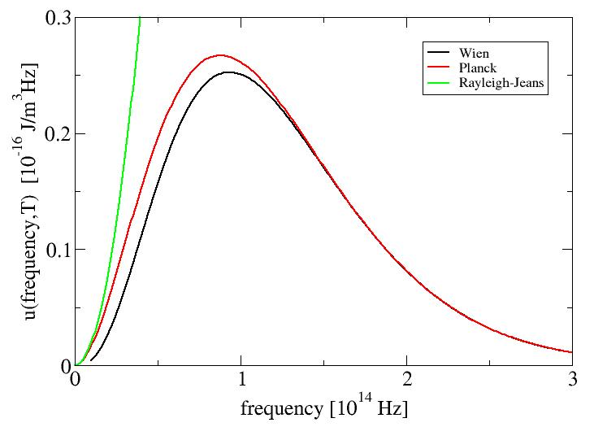
Historical models of blackbody radiation
Rayleigh-Jeans law leads to the „ultraviolet catastrophe”
Wien equation does not fit well low frequency range
Planck’s formula is true

Slide 23
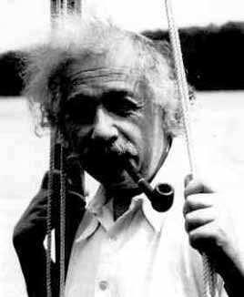
Blackbody radiation
Albert Einstein
(1879-1955)
In 1905, Albert Einstein was sure that it was impossible to derive Planck’s formula – which he took as correct – from classical physics. Correctness of the full Planck formula means the end of classical physics.

Slide 24
Limits of Planck’s formula:
High frequency limit:
Wien’s result
Low frequency limit:
This can happen if f is small or T is large, or if we imagine a world in which h tends to zero (the classical world)

Slide 25
Limits of Planck’s formula:
For small x:
Then:
This is exactly the Rayleigh’s classical answer

Slide 26
Einstein’s contribution
Extremely radical proposal of energy quantization:
at the Rayleigh-Jeans, or low-frequency, end of the spectrum, the usual Maxwell description in terms of waves works
at the Wien, or high-frequency, end of the spectrum, radiation can be thought of as a „gas” of quanta
(1879-1955)
Radiation sometimes acts like particles and sometimes like waves.
energy of particle
frequency of wave

Slide 27
„Particle” nature of radiation
Experimental confirmation :
photoelectric effect (liberation of electrons from the metallic surface by illumination of certain frequency)
Compton effect (scattering of X-rays with a change of frequency)
These effects, similarly to the blackbody radiation, could not be explained by the wave-like character of electromagnetic radiation

Slide 28
Conclusions
From the mid-19th through the early 20th century, scientist studied new and puzzling phenomena concerning the nature of matter and energy in all its forms
The most remarkable success stories in all of science resulted from that (and Nobel prizes)
History of quantum mechanics, which began in mystery and confusion, at the end of century has come to dominate the economies of modern nations

